Slide 1


Randy Otoo
08/18/25

Slide 2

Outline
Executive Summary
Introduction
Methodology
Results
Conclusion
Appendix

Slide 3
Executive Summary
Summary of methodologies
Data Collection
Data Wrangling
Exploratory Data Analysis with Data Visualization(EDA)
EDA with SQL
Interactive Map with Folium
Dashboard with Plotly
Predictive Analysis
Summary of all Results
Exploratory Data Analysis Results
Interactive Analytics Demo (screenshots)
Predictive Analysis Results

Slide 4
Introduction
Project background and context
SpaceX is a private aerospace company that has revolutionize space technology, by making space travel affordable. The company advertises Falcon 9 rocket launches on its website, with a cost of $62m; other providers cost upward of $165m each , much of the savings is because SpaceX can reuse the first stage. Therefore, if we can determine if the first stage will land , we can determine the cost of a launch. For this project, we shall examine several machine learning models and then predict if SpaceX will reuse the first stage.
Questions to answer
What is the best machine learning algorithm that can be used for binary classification in this case?
Doest the rate of successful landings increase over the years?
Is there a relationship between variables such as payload mass, launch site, number of flights , orbits and the success of the first stage landing?

Slide 5

Section 1

Slide 6
Methodology
Data collection methodology:
Using SpaceX Rest API
Using Web Scrapping from Wikipedia
Perform data wrangling
Filtering the data
Dealing with missing values
Using One-hot encoding to convert categorical variable to numerical for easy model training.
Perform exploratory data analysis (EDA) using visualization and SQL
Perform interactive visual analytics using Folium and Plotly Dash
Perform predictive analysis using classification models
Build, tune, evaluate classification models to ensure best results

Slide 7
Data Collection
Data collection involved API requests from SpaceX and Web Scraping from tables in SpaceX’s Wikipedia website.
Data Columns are obtained by using SpaceX REST API.
Data columns were : Flight No. , Launch site, Payload Mass , Orbit, among others

Slide 8
Data Collection – SpaceX API
Requesting rocket launch data from SpaceX API.
Decoding the response content using .json() and turning it into a dataframe using .json_normalize().
Requesting needed info about the launches from SpaceX API by applying custom functions.
Constructing data we have obtained into a dictionary.
Creating a dataframe from the dictionary.
Filtering the dataframe to only include Falcon9 Launches , remove Falcon 1.
Replace missing values of Payload Mass column with calculated mean for this column.
Exported the data to CSV.

Slide 9
Data Collection - Scraping
Request falcon 9 launch data from Wikipedia
Creating a Beautiful Soup object from the HTML response.
Extracting all column names from the HTML table header.
Collecting the data by parsing the HTML tables
Constructing data we have obtained into a dictionary.
Creating a data frame from the dictionary.
Exporting the data to CSV.

Slide 10
Data Wrangling
Identified and replaced missing values with mean eg. avg_payload.
Used value_counts() on column LaunchSite for number of launches in each site.
Created a landing outcome label from Outcome column.
Landing_class = 0 if bad outcome
Landing_class – 1 otherwise.
https://github.com/RandyOtoo/Randy_Applied_DataScience_Capstone/blob/main/SpaceX_notebooks/labs-jupyter-spacex-Data%20wrangling%20(1).ipynb

Slide 11
EDA with Data Visualization
Some charts plotted:
Flight Number vs Payload mass
Flight Number vs Launch site
Payload Mass vs Lauch Site.
Orbit Type vs Success Rate
Flight Number vs Orbit Type
Line charts and Bar charts
The goal is to show if there is/are any significant relationships between these variables since they can be important for the machine learning model.
https://github.com/RandyOtoo/Randy_Applied_DataScience_Capstone/blob/main/SpaceX_notebooks/EDA_dataviz%20(1).ipynb

Slide 12
EDA with SQL
Performed SQL queries:
Display the names of unique launch sites.
Display 5 records where launch sites begin with sting ‘CCA’.
Display the total payload mass carried by booster launched by NASA(CRS).
Display the average payload mass carried by booster version F9 v1.1
List the names of boosters which have success in drone ship and have payload mass greater than 4000 but less than 6000.
List the total number of successful and failed mission outcomes.
List the names of the booster versions which have carried the maximum payload mass.
List the failed landing outcomes in drone ship, their booster versions and launch site names for months in year 2015
Rank the count of landing outcome(such as Failure(drone ship) or Success(ground pad) between the date 2010-06-04 and 2017-03-20 in descending order

Slide 13
Build an Interactive Map with Folium
Markers on all launch sites;
Added marker with Circle, Pop-up label and Text label of NASA Johnson Space Center using its longitude and latitude coordinates as a start location. Added folium markers with circle, pop-up and text label of all launch sites using their longitude and latitude coordinates to show the geographical location and proximity to the equator and coast.
Colored Markers of the launch outcomes for each launch site;
Added colored markers(green) and failed(red) launches using marker cluster to identify which launch sites have relatively high success rates.

Slide 14
Build a Dashboard with Plotly Dash
Site selection dropdown: Options: "All Sites” + individual launch site
Pie Chart(Success Analysis): Shows total success vs failure for specific sites.
Slider of Payload Mass Range : Added a slicer to select Payload range.
Scatterplot(Payload vs Success Correlation): color-coded by Booster version category
Added a scatter chart to show flight number vs Launch Site: color-coded by Mission outcome(Success/Failure). I added this to show launch progression, launch site usage and success rate .

Slide 15
Predictive Analysis (Classification)
Create a NumPy array from column “Class” in data and assigned to variable Y.
Standardize data with StandardScaler() in X , reassign to X using fit_transform to transform the data.
Use the function train_test_split() to split data into training and test sets 80% to 20% respectively.
Create a GridsearchCV object with cv=10 to find best parameters.
Apply GridsearchCV on logreg, SVM, Decision tree and Knn models.
Calculated the accuracy on the test data using the method score.
Examine the confusion matrix for all models .
Compare and find method that performs best.

Slide 16
Results
Exploratory data analysis results
Interactive analytics demo in screenshots
Predictive analysis results

Slide 17

Section 2

Slide 18
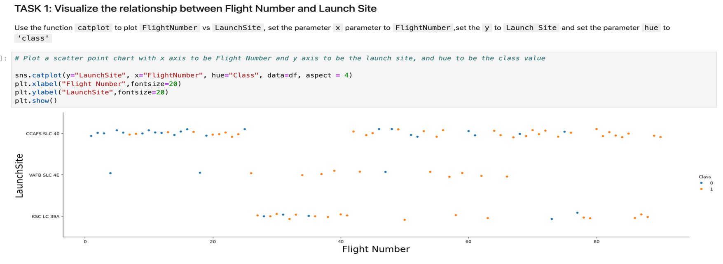
Flight Number vs. Launch Site
The plot shows that success rate improved significantly over time, with early flights having more failures and later flights being predominantly successful. It also shows the evolution of launch site usage, with CCAFS SLC 40 being heavily used early on, while KSC LC 39A became more prominent in later, higher-numbered flights.

Slide 19
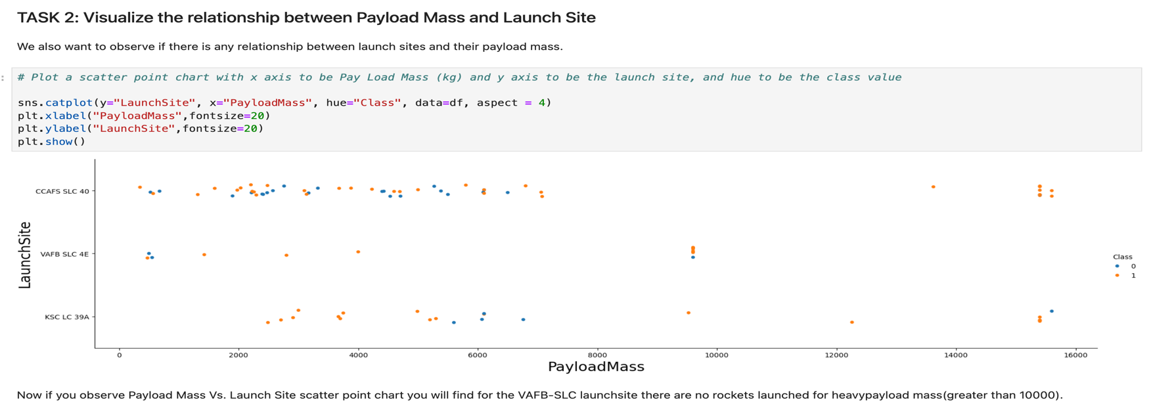
Payload vs. Launch Site
This scatter plot shows how payload mass varies by launch site, with mission success (orange) and failure (blue) indicated by color. Notably, the KSC LC 39A site has a 100% success rate for payload mass under 5500kg. Also, at every launch site , as payload mass increases , there is a higher chance of successful landing.

Slide 20
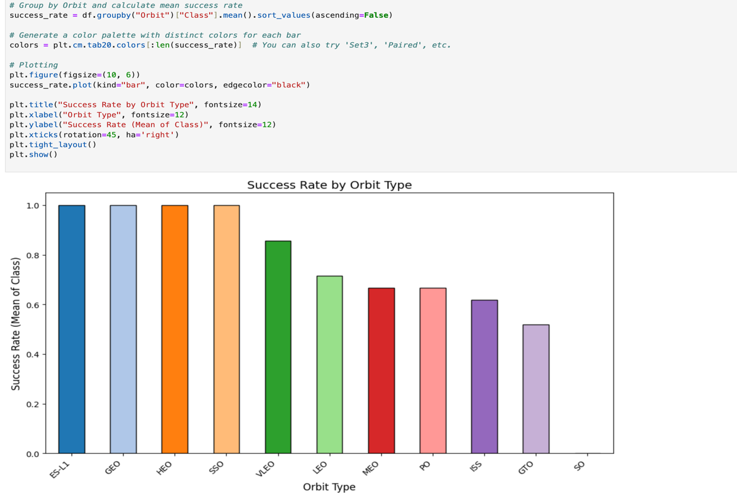
Success Rate vs. Orbit Type
Each bar shows the average success rate for missions to different orbits. SSO,ES-L1, GEO and HEO have the highest success, while GTO,ISS,PO and LEO have lower rates.
Orbit with 0% success rate is SO.

Slide 21
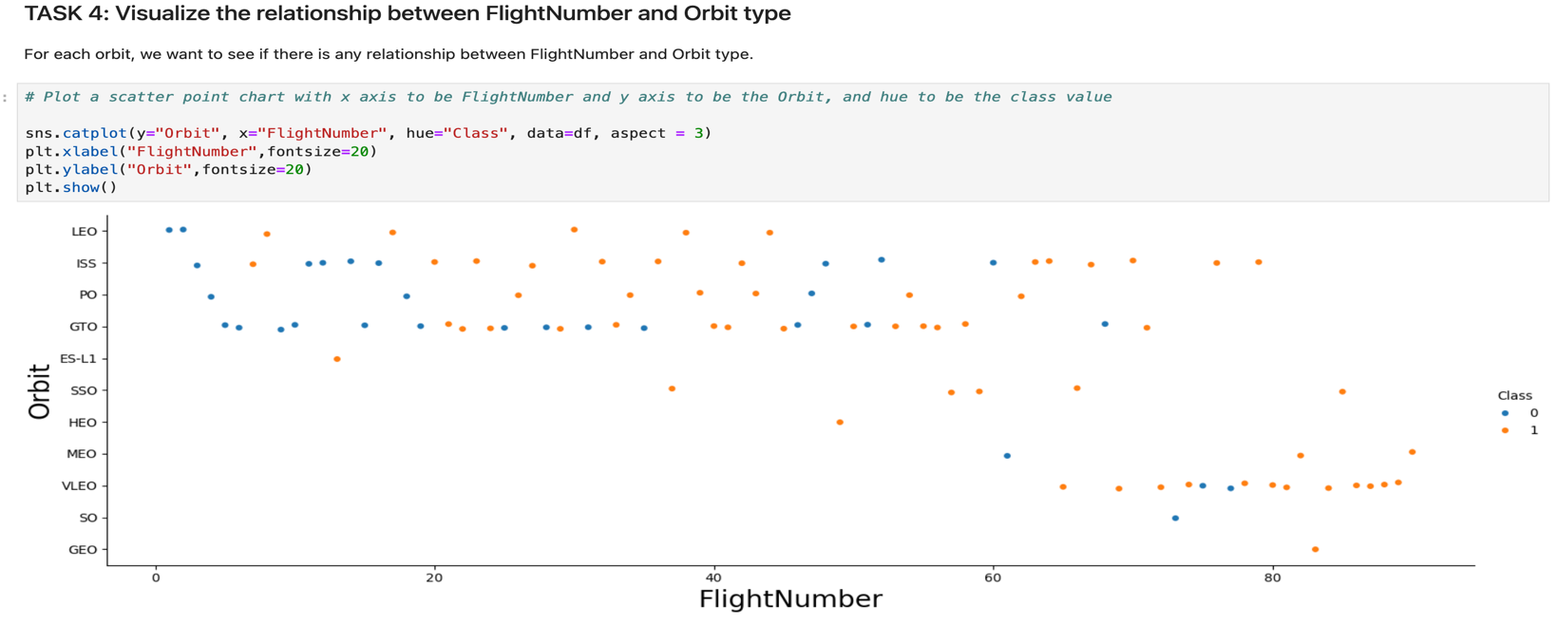
Flight Number vs. Orbit Type
This scatter plot shows how SpaceX flight numbers relate to orbit types, with color indicating mission success (orange) or failure (blue). It reveals that as flight numbers increase, success becomes more common across most orbits - especially LEO and SSO - highlighting SpaceX’s growing reliability over time.

Slide 22
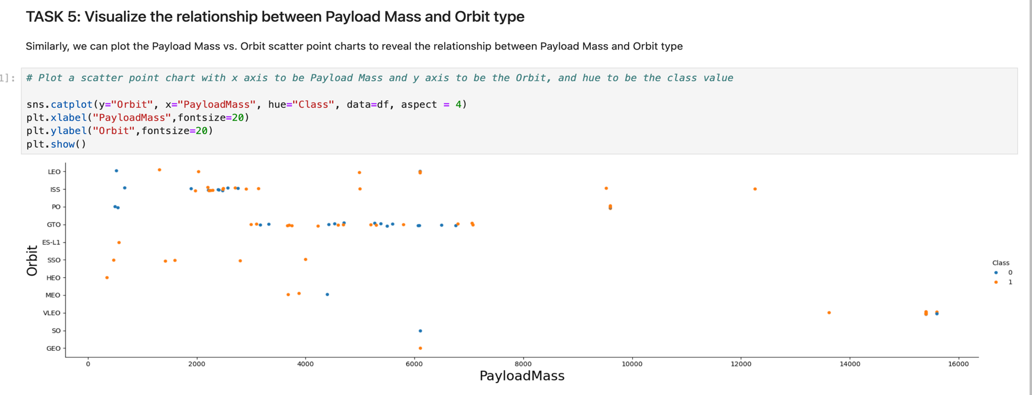
Payload vs. Orbit Type
Mission success seems more likely in SSO and LEO, especially with moderate payloads. GTO missions show more failures, possibly due to higher complexity or tighter launch constraints.

Slide 23
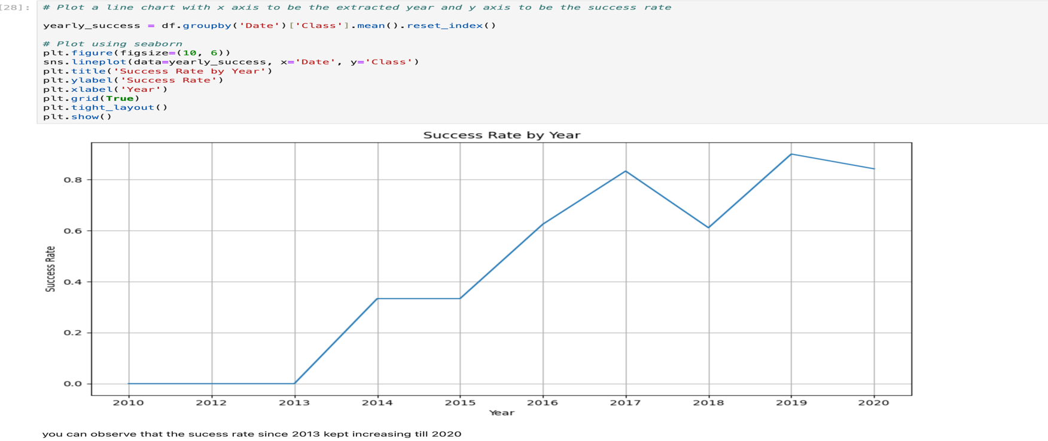
Launch Success Yearly Trend
The line chart groups the data by year, computes the average success (where 1 = success, 0 = failure), and visualizes the trend using a line chart. The result shows a clear upward trajectory in success rate from 2013 to 2020.

Slide 24
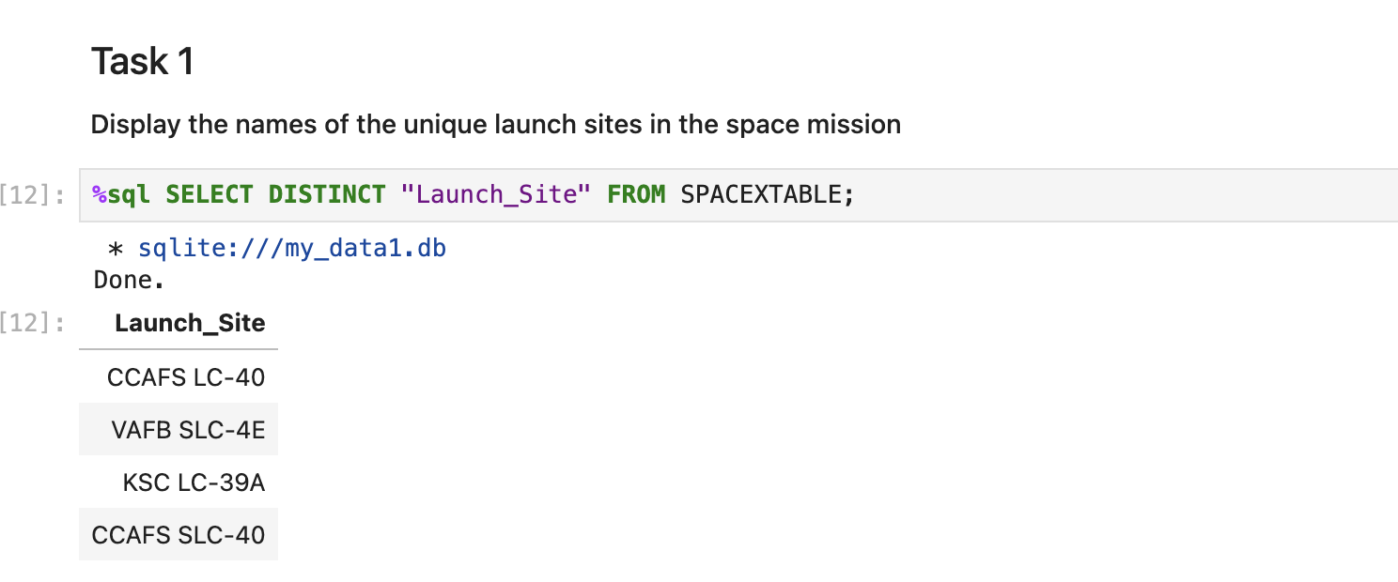
All Launch Site Names
Displaying the names of the unique launch sites in the space mission.

Slide 25
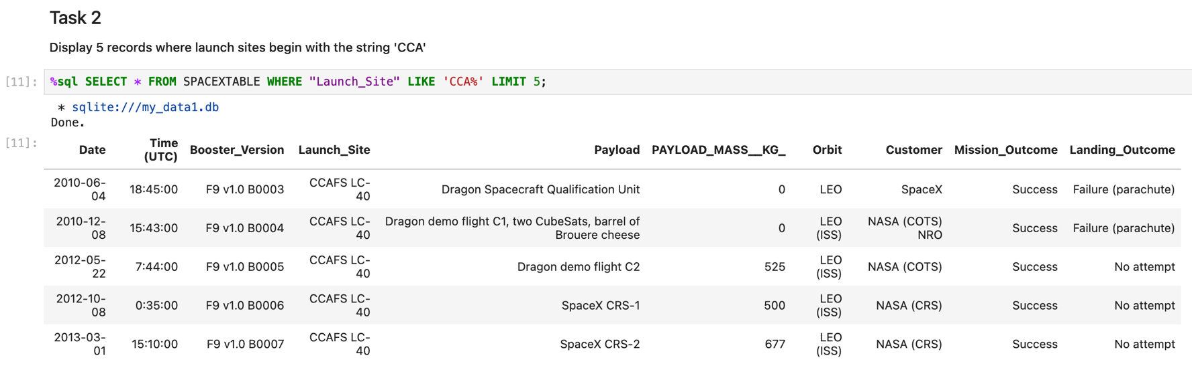
Launch Site Names Begin with 'CCA'
This is a SQL query of 5 records where launch sites names begin with CCA.

Slide 26
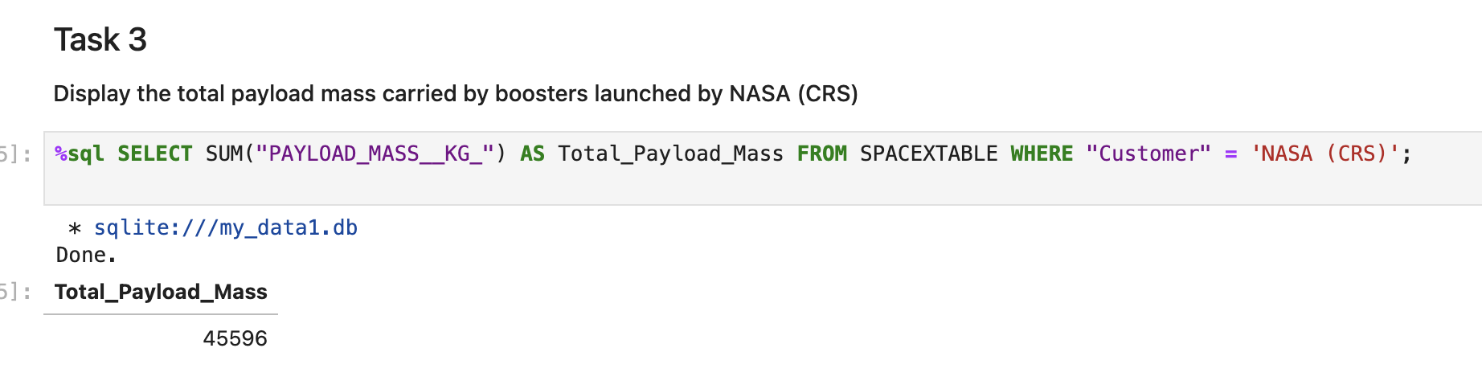
Total Payload Mass
This SQL query calculates the total payload carried by boosters from NASA.

Slide 27
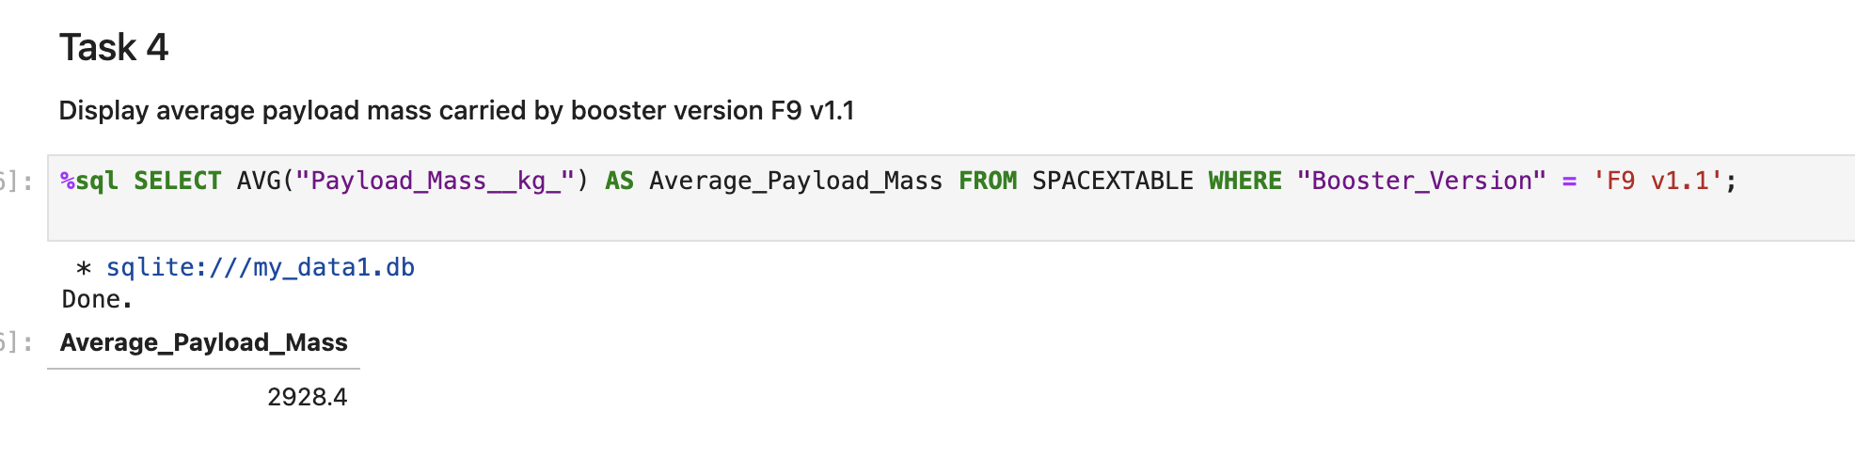
Average Payload Mass by F9 v1.1
This SQL query calculates the Average payload mass carried by booster version F9 v1.1.

Slide 28
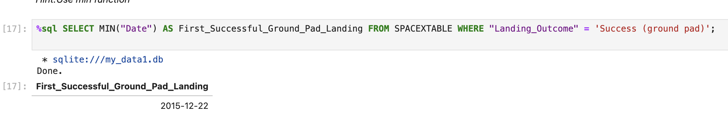
First Successful Ground Landing Date
Dates of the first successful landing outcome on ground pad.

Slide 29
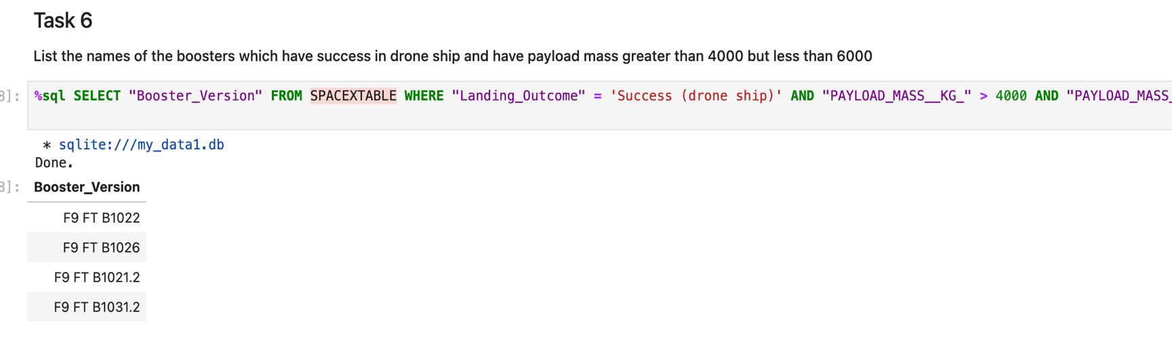
Successful Drone Ship Landing with Payload between 4000 and 6000
Names of boosters which have successfully landed on drone ship and had payload mass greater than 4000 but less than 6000.

Slide 30
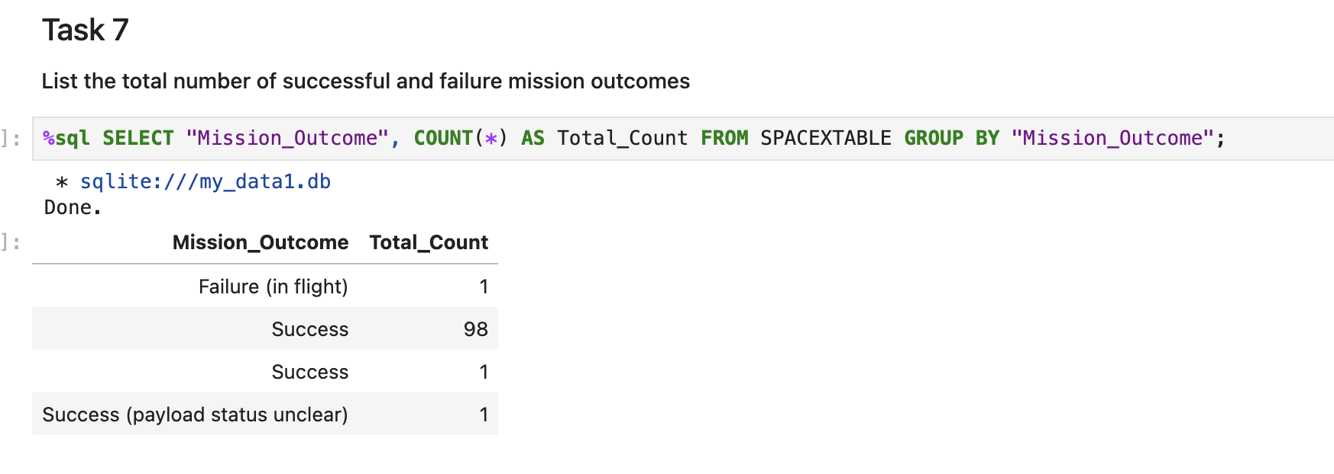
Total Number of Successful and Failure Mission Outcomes
This SQL query counts SpaceX missions by their outcome type. Shows 98 clear successes, 1 in-flight failure, and 2 ambiguous cases(success-1, success(payload status unclear)).

Slide 31
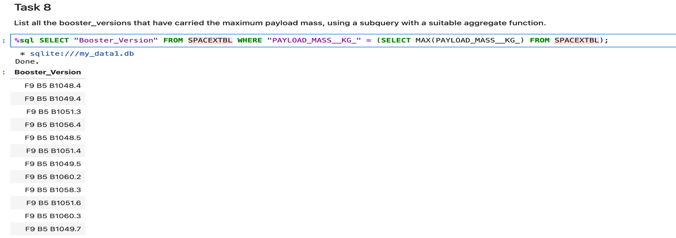
Boosters Carried Maximum Payload
Names of the different boosters which carried the maximum payload mass.

Slide 32
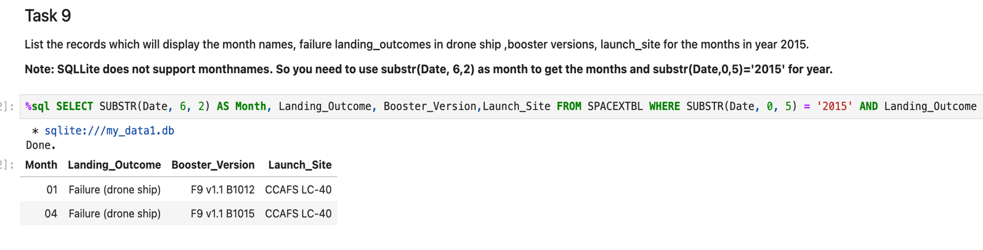
2015 Launch Records
This SQL query task filters SpaceX launches from 2015 that failed to land on drone ships. It extracts the month from the date and displays the landing outcome, booster version, and launch site. Only two such failures occurred—in January and April—both using F9 v1.1 boosters at CCAFS LC-40.

Slide 33
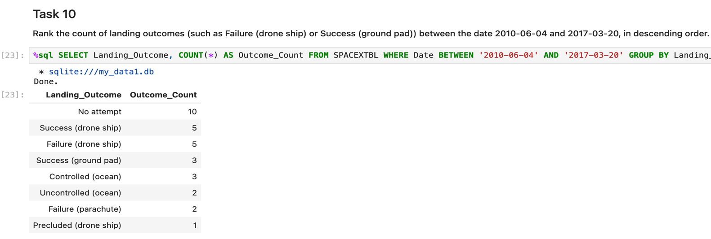
Rank Landing Outcomes Between 2010-06-04 and 2017-03-20
Between 2010 and 2017, SpaceX mostly did not attempt landings, focusing on launch reliability. Drone ship landings had mixed results - 5 successes and 5 failures - while ground pad landings were more successful. This period marked their transition from testing to mastering reusable rocket technology.

Slide 34

Section 3

Slide 35
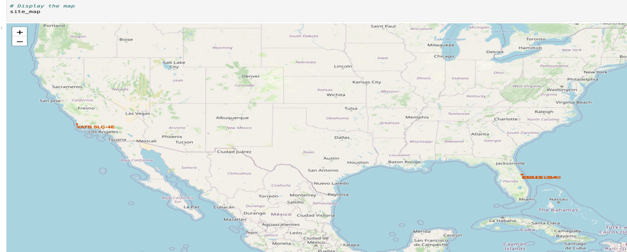
Color labeled launch outcomes
This map shows a folium map of the color-labeled launch outcomes on the map

Slide 36
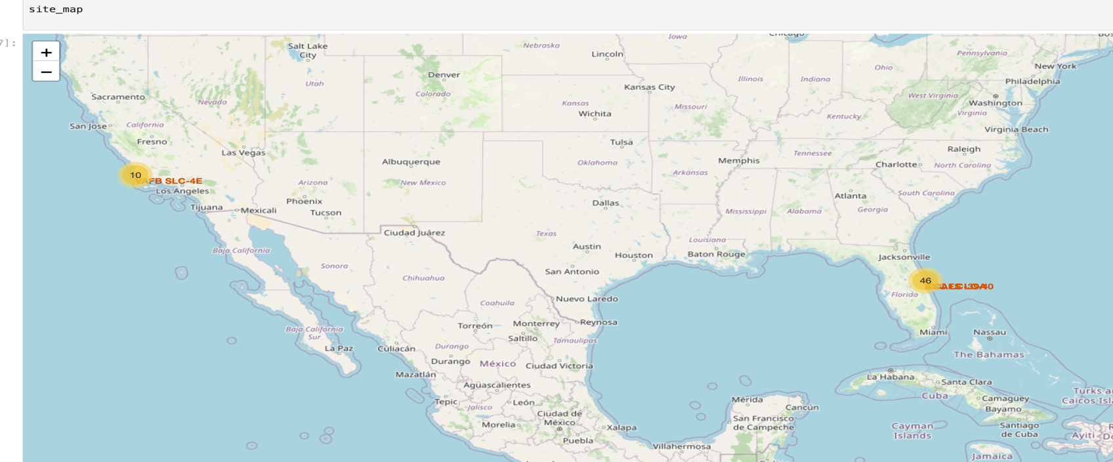
Folium Map
This folium map shows two major SpaceX launch sites in the U.S. VAFB SLC-4E in California and CCAFS LC-40 in Florida. Each marker displays the number of launches from that site

Slide 37

Section 4

Slide 38
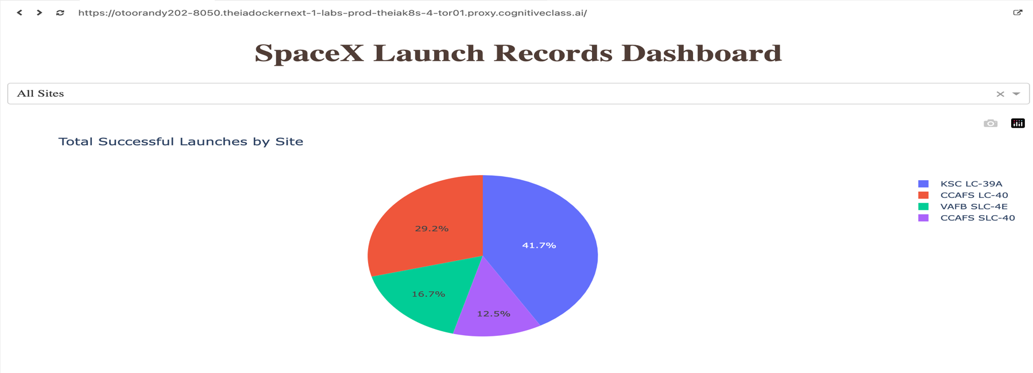
Launch success counts for all sites
KSC LC-39A leads with 41.7% of all successful launches. This site is clearly SpaceX’s most reliable or frequently used for successful missions. KSC LC-39A is likely the preferred site for high-profile or heavy-lift missions, given its strong success record.
CCAFS SLC-40 trails with 12.5%, suggesting it's either less active or has a lower success rate.

Slide 39
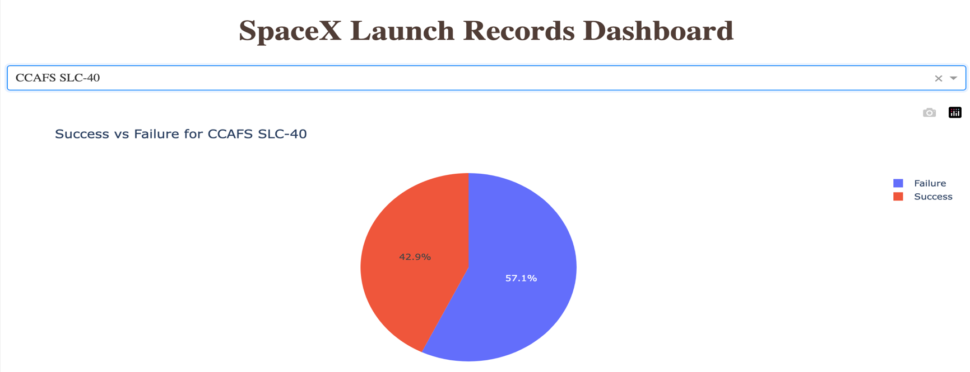
Launch Site with better failure vs success ratio
Across all launch sites, a consistent pattern emerges: failure rates exceed success rates. Yet, this particular site stands out with a comparatively lower failure rate—an unexpected finding considering SpaceX’s broader reputation for high reliability.

Slide 40
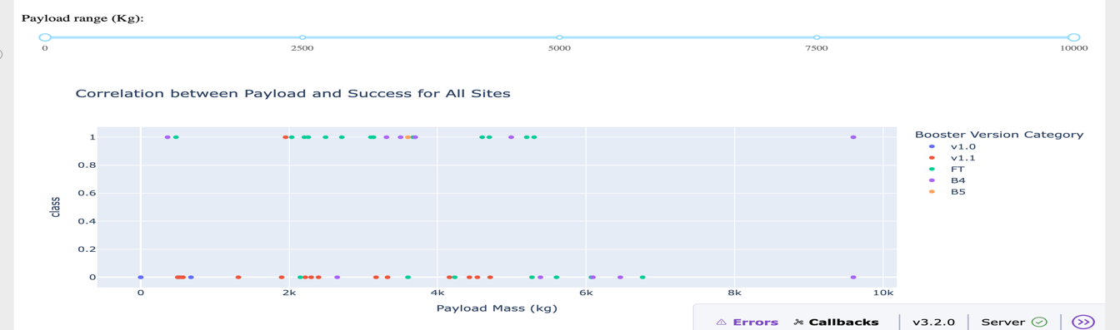
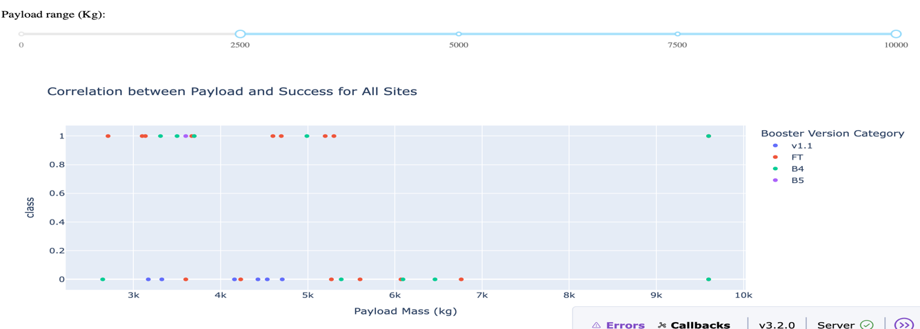
Payload Mass vs Launch Outcome(all sites)
Explanation:
From the chart, I observed that payloads between 2034kg and 5000kg have the highest success rate.

Slide 41

Section 5

Slide 42
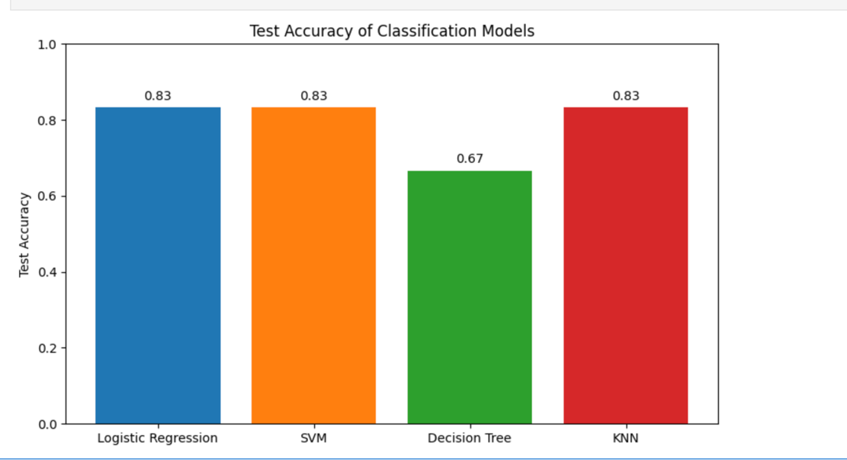
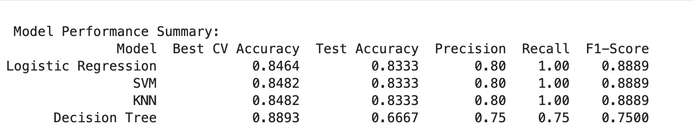
Classification Accuracy
Decision Tree has the highest CV accuracy(0.8893), but its test accuracy drops a lot(0.667) , which suggest overfitting.
Logistic Regression, SVM and KNN all show equally good performance.
However, I would pick Logistic regression because:
Simple model, easiest to interpret and low computational cost .

Slide 43
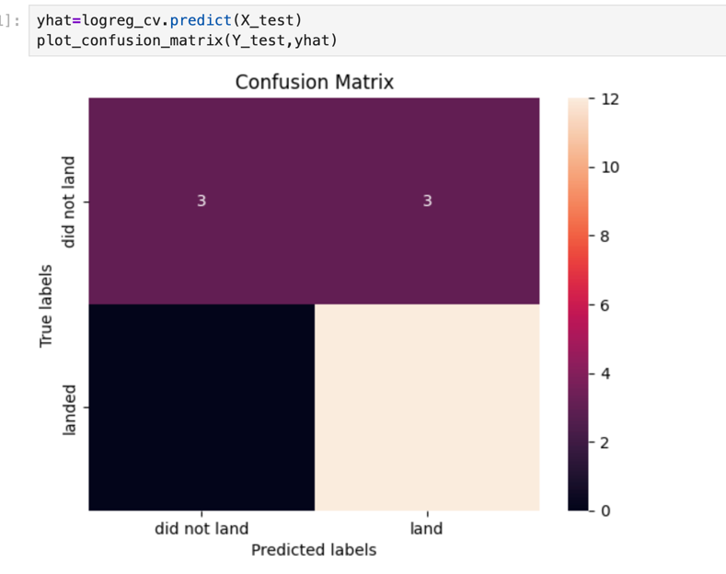
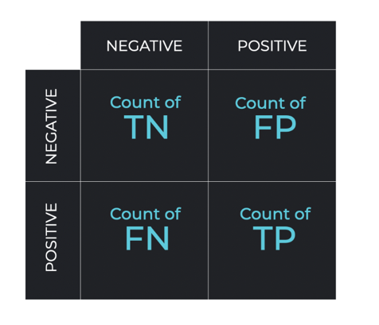
Confusion Matrix
Explanation:
Based on the confusion matrix , we see that logistic regression can distinguish between the different classes.
True Postive(TP) - 12 (True label is landed, Predicted label is also landed)
False Postive(FP) - 3 (True label is not landed, Predicted label is landed)
The model is very good at detecting landings (Recall = 1.0) it never misses a successful landing.
However, it makes some false positives (predicting “landed” when the rocket actually didn’t land).
This means the model is optimistic about landings, favoring recall over precision.

Slide 44
Conclusions
Logistic Regression, SVM and KNN all showed equally good performance.
KSC LC-39A leads with 41.7% of all successful launches. This site is clearly SpaceX’s most reliable or frequently used for successful missions. KSC LC-39A is likely the preferred site for high-profile or heavy-lift missions, given its strong success record.
CCAFS SLC-40 trails with 12.5%, suggesting it's either less active or has a lower success rate.
Decision Tree has the highest CV accuracy(0.8893), but its test accuracy drops a lot(0.667) , which suggest overfitting.

Slide 45
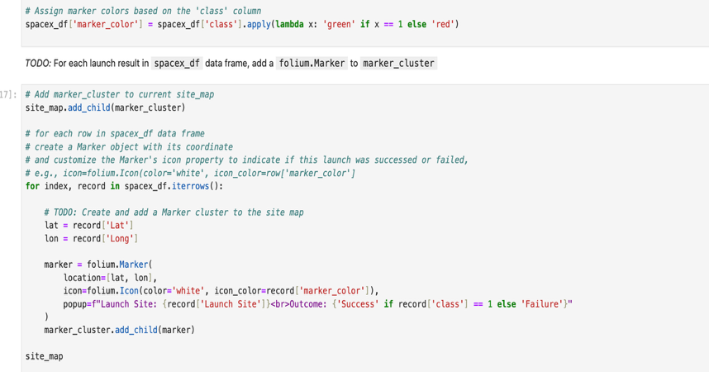
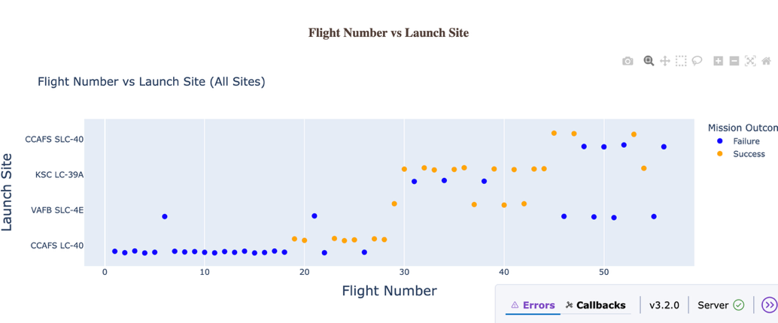
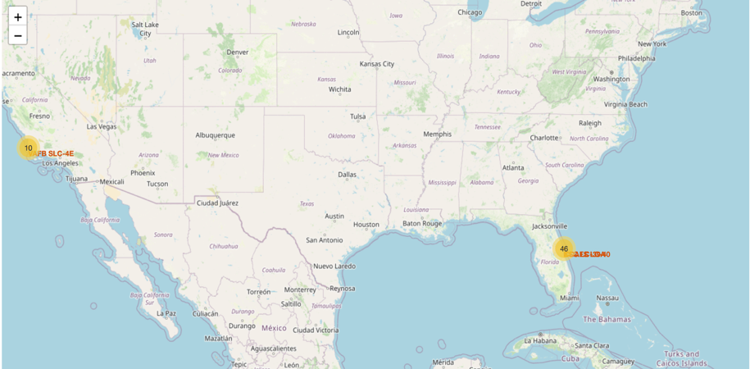
Appendix

Slide 46


